Slide 1







Sym
Briana Figueroa
Swapnil Kadekar
Morgan Franklin
Alan Singleton
Sprint 7 Presentation
Team 5
Sayema Islam
Jasmine Washington
HiddenAgility

Slide 2
Agenda
Sprint 6 Recap
Sprint 7
Project Timeline
- Sprint 8 Backlog
Retrospective
Project Demo
Conclusion
- Completed Tasks and Stories
- Deliverables
- Statistics
- Committed and Completed Artifacts with Acceptance Criteria
- Test Cases
- Burndown Chart
- Deliverables
- New SymCheck design
HiddenAgility

Slide 3
Sprint 6 Recap
HiddenAgility

Slide 4
Sprint 6 Completed Tasks and Stories
ID | Type | Summary | Status | Story Points
HID-81 | User Story | As a patient, I want to access a FAQ page so that I can see answers to common questions that I may have | Done | 1
HID-70 | Technical Task | Create a presentation for Sprint 6 | Done | N/A
HID-75 | Technical Task | Update installation guide and user manual | Done | N/A
HID-76 | Technical Task | Update Technical Paper | Done | N/A
HID-77 | Technical Task | Update Github Wiki | Done | N/A
HID-84 | Technical Task | Find 200 images of ringworm | Done | N/A
HID-85 | Technical Task | Create Mock-ups for new SymCheck Design | Done | N/A
HID-59 | User Story | As a patient, I want to include other symptoms along with my image upload so that I can receive a better diagnosis of my illness | Moved to Sprint 7 | 5
HID-73 | Technical Task | Develop a python script to clear media folder OR implement a database for uploaded pictures | Moved to Sprint 8 | N/A
We created an FAQ page and designed wireframes for our new SymCheck design
We found 200 images of ringworm to train our machine learning algorithm
We moved our advance prediction user story to Sprint 7
We moved the development of a script or database to clear uploaded images to Sprint 8
We completed 78% of our committed artifacts
HiddenAgility

Slide 5
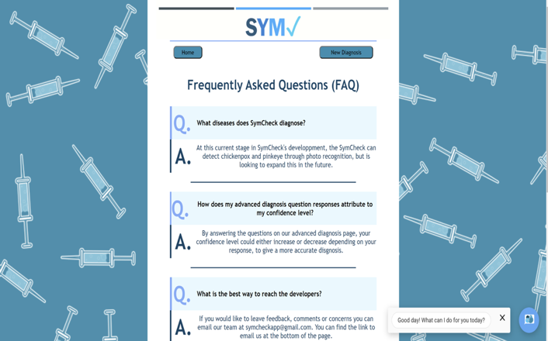
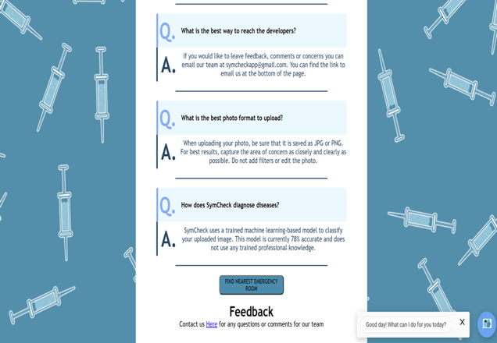
Sprint 6 Deliverable: FAQ Page
Top of Page
Bottom of Page
HiddenAgility

Slide 6
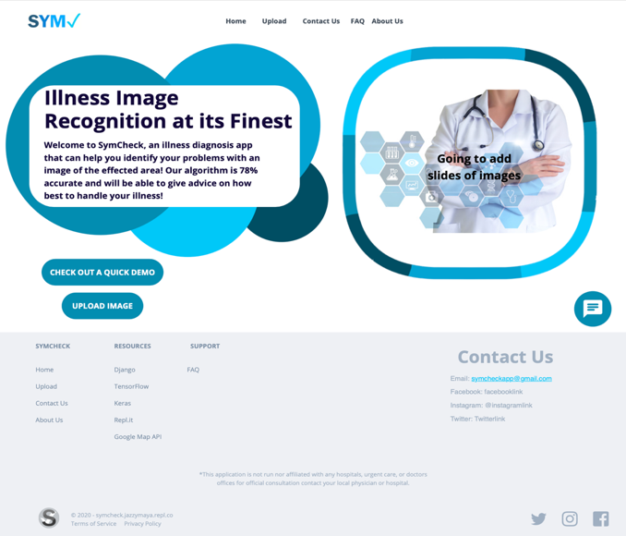
Sprint 6 Deliverable: New SymCheck Design
Homepage
HiddenAgility

Slide 7
Sprint 7

Slide 8
Sprint 7 Statistics
ID | Type | Summary | Status | Story Points
HID-59 | User Story | As a patient, I want to include other symptoms along with my image upload so that I can receive a better diagnosis of my illness. | Done | 5
HID-79 | User Story | As a patient, I want to know which illnesses SymCheck can diagnose so that I know what I can upload. | Done | 1
HID-82 | User Story | As a patient, I want to access other pages on the site with a navigation bar so that I can easily move from page to page | Done | 3
HID-93 | User Story | As a patient, I want to access an About Us page so that I can get to know more about the SymCheck creators | Done | 1
HID-71 | Technical Task | Create a presentation for Sprint 7 | Done | N/A
HID-80 | Technical Task | Add a disclaimer at the bottom of each page | Done | N/A
HID-83 | Technical Task | Redo SymCheck's application design | Done | N/A
HID-94 | Technical Task | Every member is required to log work done every weekday | Done | N/A
# of User Stories = 4
HID-59 Was pushed into this Sprint due to technical difficulties in Sprint 6
Velocity = 10
# of Technical tasks = 4
Artifacts Completed = 100%
HiddenAgility

Slide 9
Committed and Completed Artifacts
Key for Priority
High
Medium
Low
As a patient, I want to include other symptoms along with my image upload so that I can receive a better diagnosis of my illness.
Acceptance Criteria: Given that the patient is on the upload page, when the patient submits an image, then the patient is redirected to an advance page where they can answer questions with “Yes” or “No” radio options.
HID-59 User Story
Points: 5
HID-94 Technical Task
Every member is required to log work done every weekday.
HID-82 User Story
Points: 3
As a patient, I want to access other pages on the site with a navigation bar so that I can easily move from page to page.
Acceptance Criteria: Given that the patient is on any page of SymCheck, when the patient clicks on “Home”, “Upload”, “FAQ”, or “About us”, then the patient will be redirected to the respective webpage.
HID-83 Technical Task
Redo SymCheck’s application design
As a patient, I want to access an About Us page so that I can get to know more about the SymCheck creators.
Acceptance Criteria: Given that the patient is on any page, when the patient clicks on the “About Us” link, then the patient will be redirected to the About Us page and can read about each team member and see their photo.
HID-80 Technical Task
HID-93 User Story
Points: 1
Add a disclaimer at the bottom of each page
HID-71 Technical Task
HID-79 User Story
Points: 1
As a patient, I want to know which illnesses SymCheck can diagnose so that I know what I can upload.
Acceptance Criteria: Given that the patient is on the Homepage, when the user is reading the SymCheck info box, then the user.
Create a presentation for Sprint 7
HiddenAgility

Slide 10
Sprint 7 Test Cases
Advance Prediction Page
ID | Test Case For | Test Case | Test Data | Expected Result | Actual Result | Pass/Fail
HID-59 | Advance Prediction Page | Directed to Advance Prediction |  | Patient will be directed to Advance Prediction Page after submitting photo | After submitting a photo for analysis, the Advance Prediction Page will appear | Pass
HID-59 | Advance Prediction Page | Chickenpox | chickenpox image file | Patient will be asked questions about chickenpox | After submitting a chickenpox photo, the questions on the Advance Prediction are based upon this illness. | Pass
HID-59 | Advance Prediction Page | Pink Eye | pink eye image file | Patient will be asked questions about pink eye | After submitting a pink eye photo, the questions on the Advance Prediction are based upon this illness. | Pass
HID-59 | Advance Prediction Page | Complete All Answers |  | Patient will have to complete all answers | When choosing to answer the advanced questions must answer all of them to submit and move on to the results. If you don't answer one question an alert will pop up to answer that question | Pass
HID-59 | Advance Prediction Page | Submit Answers |  | Patient can submit answers to Advanced Questions | Once completing all questions, you can submit the answers to help further diagnosis your illness. | Pass
HID-59 | Advance Prediction Page | Skip to Results |  | Patient can skip Advance Questions and go to Results Page | If someone doesn't want to answer the Advanced Page questions, then clicking the skip to results button will send them to the results page | Pass
HiddenAgility

Slide 11
Sprint 7 Test Cases
About Us Page
ID | Test Case For | Test Case | Test Data | Expected Result | Actual Result | Pass/Fail
HID-93 | About Us | About Us | N/A | Patient can locate About Us page | In the NavBar you will find About Us, once selected you will be redirected to this page | Pass
HID-93 | What is SymCheck | What is SYMCheck | N/A | Patient can see what SYMCheck Application does | Underneath the NavBar you will see a short description about what the application does | Pass
HID-93 | Meet the Team | Meet the Team | N/A | Patient can see all of the team members who created SYMCheck | Below the What is SYMCheck section you will see Meet the Team. With a list of our team members with pictures and the description of our roles. | Pass
HID-93 | Chatbot | Chatbot | How can I get in touch with developers? | Patient can interact with SymBot and receive a response | SymBot responds on all patient inputs such as hello, what is chickenpox, how can I speak to creators of symcheck, etc. | Pass
HiddenAgility

Slide 12
Sprint 7 Test Cases Continued
ID | Test Case For | Test Case | Expected Result | Actual Result | Pass/Fail
HID-79 | Homepage | Illness Diagnosed | Patient can see which illnesses SymCheck can check for | Patient can see what illnesses SymCheck can diagnose as well as its machine learning accuracy percentage | Pass
HID-80 | All Pages | Disclaimer | Patient can see disclaimer in the footer | In the footer, there is a disclaimer saying we are not medical professionals | Pass
HID-80 | All Pages | Footer Links | Patient can click on any links in footer and be redirected to respective pages | In the footer, all links under SymCheck, Resources, Support, and Contact Us take you to the correct page | Pass
HID-82 | All Pages | Navigation Bar | Patient can move to all pages that does not rely on user input on site using Navigation bar | Patient can click any link in Navigation Bar and is redirected to the Home, Upload, FAQ, or About Us Page | Pass
HID-83 | All Pages | Footer | Patient can access footer along all pages throughout the web application | On every page, the patient has access to the same footer elements | Pass
HiddenAgility

Slide 13
Burndown Chart

Slide 14
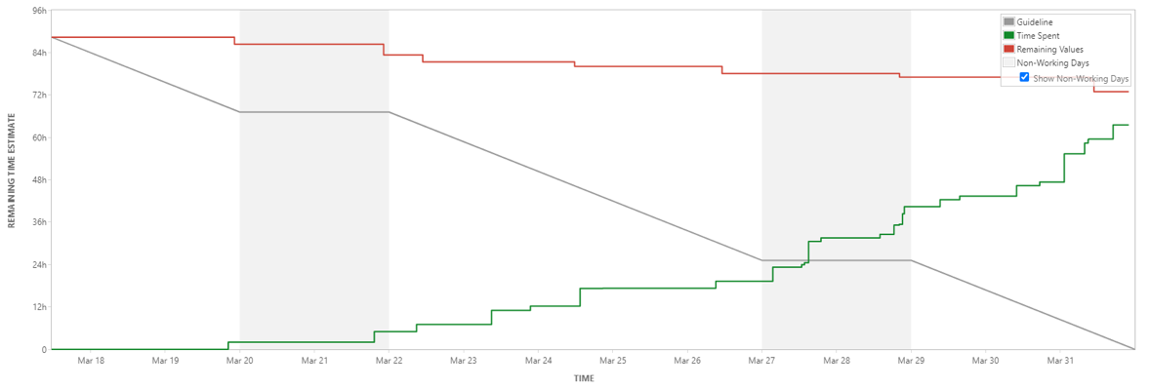
Sprint 7 Burndown Chart
We finished our work earlier than the time we estimated in our Sprint Planning Meeting
The green shows how often we logged our work
The red shows an error with Jira, it did not adjust the Remaining Time Estimate figure when we logged our work
Notes:
Read bullet points

Slide 15
Sprint 7 Deliverables

Slide 16
Redesigned SymCheck Home Page
After
Before

Slide 17
Redesigned SymCheck Upload Page
After
Before

Slide 18
New SymCheck Advanced Prediction Page - Chickenpox

Slide 19
New SymCheck Advanced Prediction Page - Pinkeye

Slide 20
Redesigned SymCheck Results Page
After
Before

Slide 21
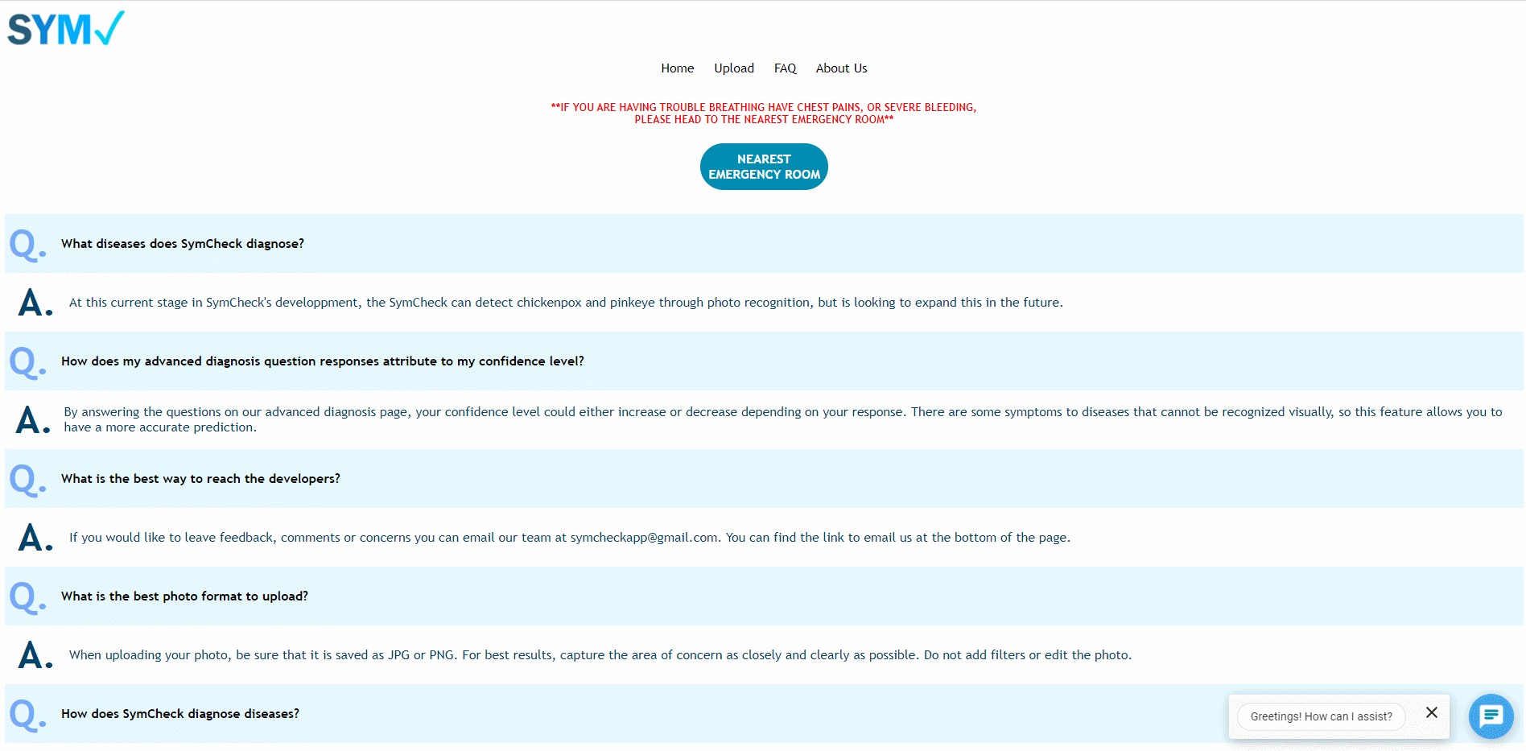
New SymCheck FAQ Page

Slide 22
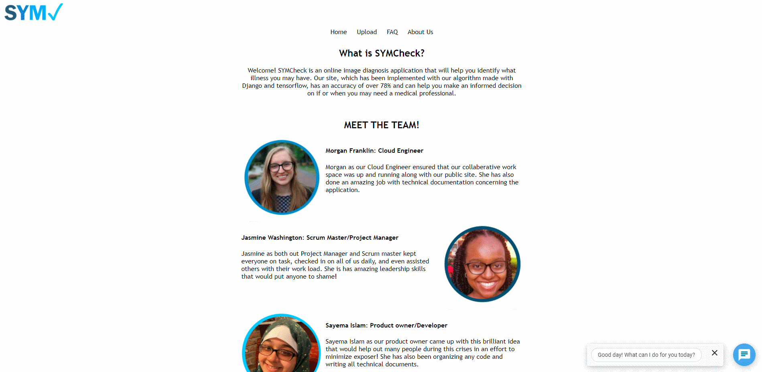
New SymCheck About Us Page

Slide 23
Project Timeline
HiddenAgility

Slide 24
Sprint 8 (April 6 – April 27)
ID | Type | Summary | Priority | Status | Story Points
HID-62 | User Story | As a patient, I want to access the SymCheck application on the web so that I don’t have to download and run an instance myself | High | In Progress | 8
HID-64 | User Story | As a patient, I want to access SymCheck on my mobile device for convenience | High | To Do | 5
HID-73 | Technical Task | Develop a python script to clear media folder OR implement a database for uploaded pictures | High | To Do | N/A
HID-78 | Technical Task | Add ringworm as another illness that can be predicted | High | To Do | N/A
HID-88 | Technical Task | Set up AWS environment for development and production | High | In Progress | N/A
HID-95 | User Story | As a patient, I want to be able to easily understand my illness is so that I know how serious it is | Medium | To Do | 3
HID-96 | Technical Task | Optimize SymCheck code | Medium | To Do | N/A
HID-72 | Technical Task | Create a presentation for Sprint 8 | Low | To Do | N/A
HiddenAgility

Slide 25
Retrospectives
HiddenAgility

Slide 26
Retrospectives
What went well
Logging work more consistently
Coding in a cloud collaborative environment
Meaningful tri-weekly meetings
1
2
3
What needs improvement
Identifying bugs before marking stories “done”
Communicating new feature ideas effectively
Coding initially with optimization in mind
Coding initially with optimization in mind
Next Steps
HiddenAgility

Slide 27
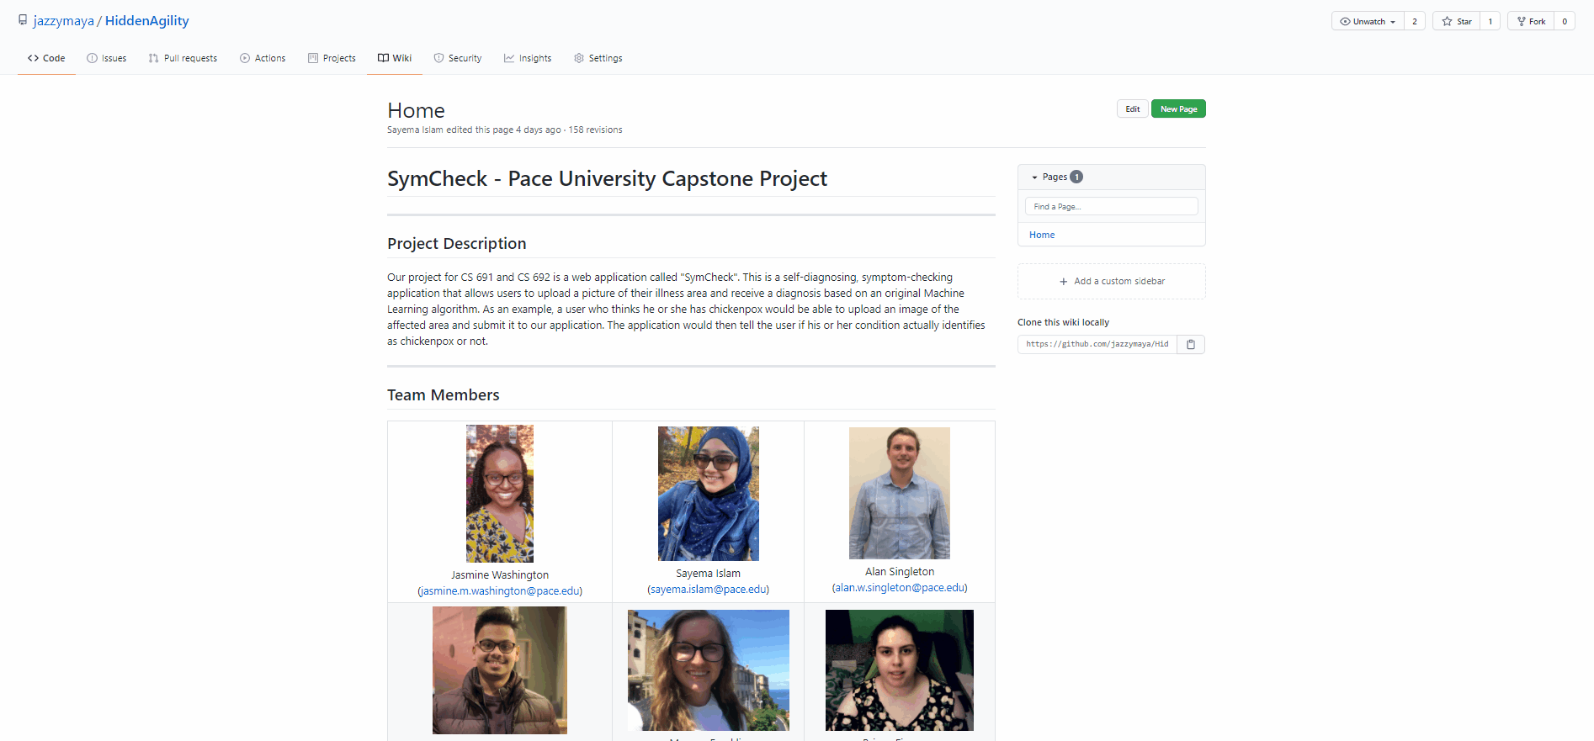
Link to GitHub
Conclusion
https://github.com/jazzymaya/HiddenAgility/wiki
HiddenAgility

Slide 28
Project Demo

Slide 29
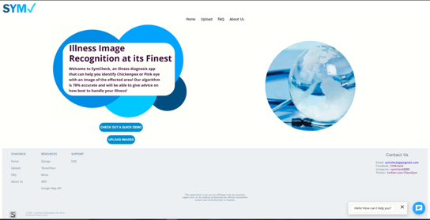
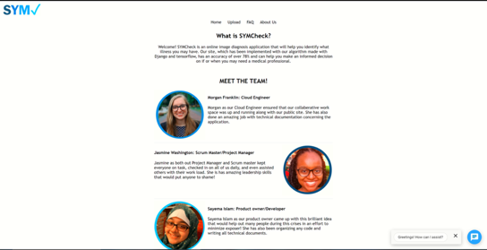
Project Demo
Project Demo Screenshots

Slide 30
Live Demo was performed by Briana Figueroa.
Please watch our Deliverable 7 Presentation on our GitHub Wiki Page!

